Slide 1
Bit 302 software engineering
Final Refinement
Luh Wulandari Maharani (E1700873)
Rivaldo Bagus Soepardhy (E1700882)

Slide 2
Introduction
Every software development must have a clear and understandable requirement or specification to ensure developers can keep developing software within the boundary of requirement, while also, developer can adjust to what users need with the software, and developers can optimize the software according to users’ need.

Slide 3
FUNCTIONAL REQUIREMENT
HousingOfficer requirement
HousingOfficer has login menu that can be filled with user ID and password to go directly to HousingOfficer homepage.
HousingOfficer can change the password if HousingOfficer forget their password.
HousingOfficer must have “edit menu” which is can edit residence detail.
HousingOfficer must have “add menu” which is can set up new residence.
HousingOfficer must have “delete menu” which is can delete applicant and residence detail.
HousingOfficer must have “view menu” which is can view applications and residence details.
Payment menu to display payment details for applicant, which is designed by HousingOfficer.
Logout Menu to exit from the application.

Slide 4
FUNCTIONAL REQUIREMENT
Applicant Requirement
Applicant will register where the form has been given.
Applicant has login menu that can be filled with user ID and password so that the applicant can access the system without confusion, and will be directed to the home page.
Applicant can change the password if applicant forget their password.
The system has a menu with buttons or icons that applicants can choose from view application, view residences, wish list, submit applications and payment.
Logout Menu to exit from the application.

Slide 5
NON-FUNCTIONAL REQUIREMENT
Requirement | Description
Security requirement | Using login system for authorization to prevent unauthorized access of certain parties.
Usability | The system should be easy to access for Housing Officer and Applicant.
Integrity | Data inside the system will be keep as it is untampered and unharmed.
Modifiability | Data can only be change by authorized user (HousingOfficer).

Slide 6
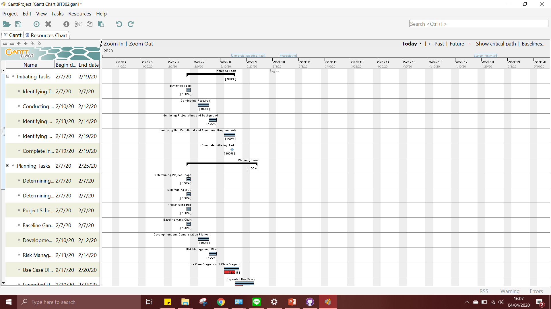
Gantt Chart

Slide 7
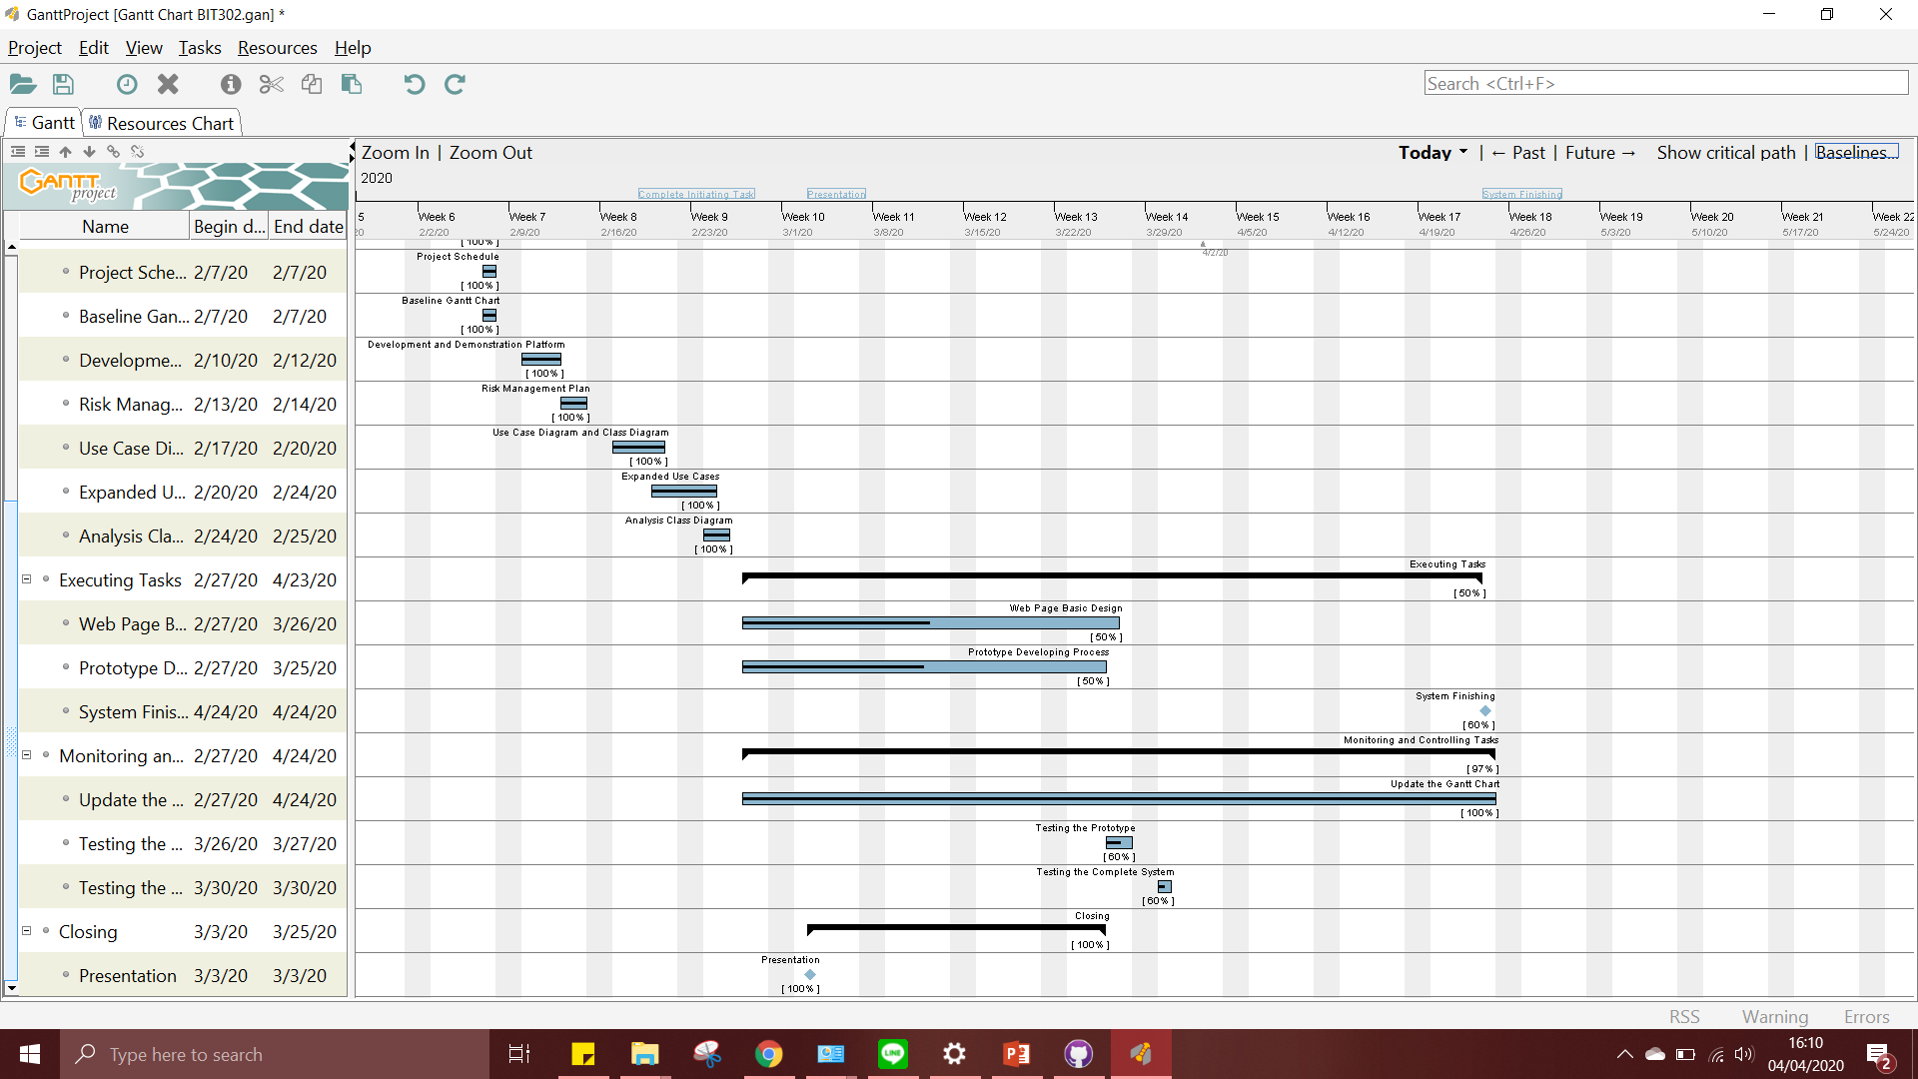
Gantt Chart

Slide 8
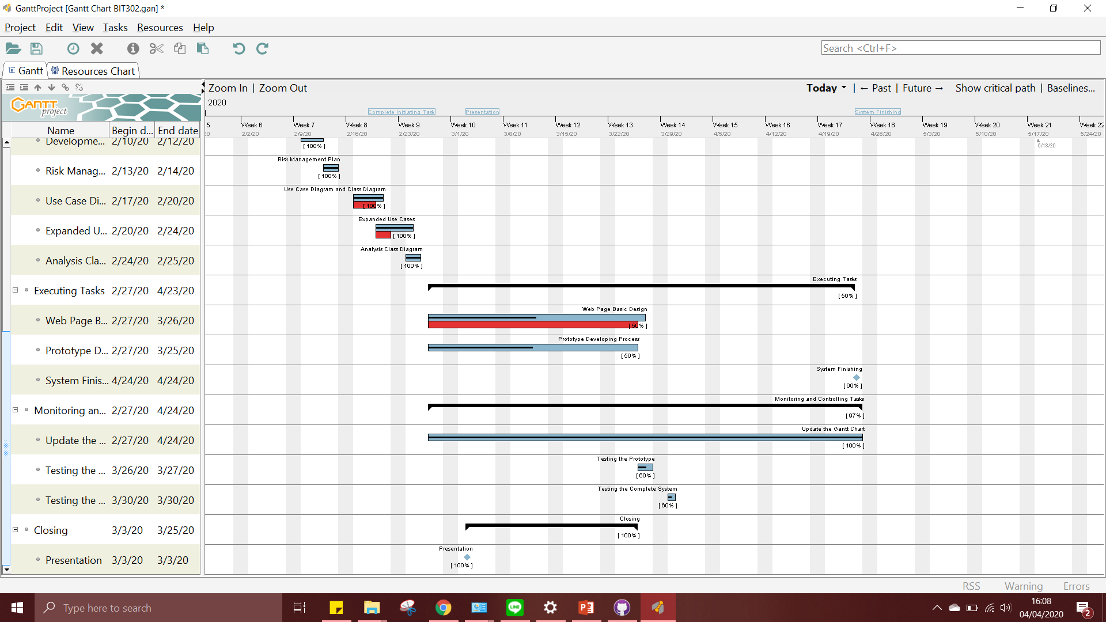
Baseline Gantt Chart

Slide 9
USE CASE

Slide 10
Use Case | Sign Up
Goal in Context | Allow Applicant create account for login to application
Primary Actor Secondary Actor | Applicant -
Typical Course of Events
Actor Actions | System Response
The process start when applicant click the sign up button | System will redirected to the sign up form
Applicant will fill the form with all the information
Applicant submit all personal information | System will save new information to the database
Alternative Course
If the username already used by another user the applicant will make new username

Slide 11
Use Case | Login
Goal in Context | Allow HousingOfficer and Applicant access the main page
Primary Actor Secondary Actor | HousingOfficer and Applicant -
Typical Course of Events
Actor Actions | System Response
The process starts when the user input their ID user and password and press the login button | The system will validate the information received
 | System will display the homepage for HousingOfficer or Applicant
Alternative Course
If the HousingOfficer or Applicant inputs an incorrect user ID or password then the system will display notification if the information entered is incorrect, and HousingOfficer or Applicant must fill in with correct user ID and password.

Slide 12
Use Case | Log Out
Goal in Context | Allow HousingOfficer and Applicant exit from the application
Primary Actor Secondary Actor | HousingOfficer and Applicant -
Typical Course of Events
Actor Actions | System Response
The process starts when the user clicks the Log Out button | System will exit the user from the main page
Alternative Course

Slide 13
Use Case | Change Password
Goal in Context | Allow HousingOfficer and Applicant changed their password
Primary Actor Secondary Actor | HousingOfficer and Applicant -
Typical Course of Events
Actor Actions | System Response
Process occurs when the HousingOfficer or Applicant login
HousingOfficer or Applicant will select the chang Password button | System will display a form for change password that must be filled with a new password
HousingOfficer or Applicant will fill in with new password and one – time validation
HousingOfficer or Applicant will press the submit button
 | System will save the update in the database
Alternative Course
If there is a third of mismatch password event, then a message will appear and the new password will not be submitted

Slide 14
Use Case | View Applications
Goal in Context | Allow HousingOfficer to see the whole applications form
Primary Actor Secondary Actor | HousingOfficer Applicant
Typical Course of Events
Actor Actions | System Response
HousingOfficer can access the page where there is a list of applicants | System will display page that containing the applicant
Alternative Course

Slide 15
Use Case | View Applications
Goal in Context | Allow Applicant to see the whole application
Primary Actor Secondary Actor | Applicant HousingOfficer
Typical Course of Events
Actor Actions | System Response
Applicant wants to see Application list | The system will display the Applications page
Alternative Course

Slide 16
Use Case | View Residence
Goal in Context | Allow HousingOfficer to see the whole residence detail form
Primary Actor Secondary Actor | HousingOfficer -
Typical Course of Events
Actor Actions | System Response
HousingOfficer wants to see list of residence | System will display page that containing the residence detail
Alternative Course

Slide 17
Use Case | View Residences
Goal in Context | Allow Applicant to see list of residence
Primary Actor Secondary Actor | Applicant HousingOfficer
Typical Course of Events
Actor Actions | System Response
Applicant wants to see list of residence | The system will display the Residences page
Alternative Course

Slide 18
Use Case | Allocate Housing
Goal in Context | Allow HousingOfficer to book applicant who have booked slots that have long been ordered and will be sorted again
Primary Actor Secondary Actor | HousingOfficer -
Typical Course of Events
Actor Actions | System Response
1. HousingOfficer will check the applicants one by one
2. HousingOfficer will select certain Applicant/Applications to be allocated, click allocate | 3. The system will save the information that has been entered by HousingOfficer
Alternative Course

Slide 19
Use Case | Set Up New Residence
Goal in Context | Allow HousingOfficer to input new residence information
Primary Actor Secondary Actor | HousingOfficer -
Typical Course of Events
Actor Actions | System Response
1. Housing Officer click Set Up New Residence | 2. System Display the Form
3. Housing Officer input the data needed, click submit | 4. System save the data to the database, HousingOfficer will be redirected to View Residence page.
Alternative Course

Slide 20
Use Case | Delete Applicant
Goal in Context | Allow HousingOfficer to delete Applicant
Primary Actor Secondary Actor | HousingOfficer -
Typical Course of Events
Actor Actions | System Response
HousingOfficer will select the Applicant to delete | System will receive information which will be deleted
 | System delete Applicant from database. System Redirect HousingOfficer to Dashboard
Alternative Course
-

Slide 21
Use Case | Edit Residence
Goal in Context | Allow HousingOfficer to change the information about the residence
Primary Actor Secondary Actor | HousingOfficer -
Typical Course of Events
Actor Actions | System Response
1. HousingOfficer choose which residence to change, click edit | 2. The system will display the residence form
3. HousingOfficer will replace data that needs to be updated. Click Done. | 4. System will save changes and will update the information that will be displayed in residence page
Alternative Course
-

Slide 22
Use Case | Submit Applications
Goal in Context | Allow Applicant to enter Application to a residence
Primary Actor Secondary Actor | Applicant HousingOfficer
Typical Course of Events
Actor Actions | System Response
Applicant click View Residence | 2. System show list of residence
3. Applicant click Submit Application | 4. System show application form
5. Applicant fills the form with data that are required, click submit | 6. System save the data to the database, system redirect Applicant to dashboard.
Alternative Course
If the information entered by the applicant is incorrect, the applicant will refill it again

Slide 23
Use Case | Edit Application
Goal in Context | Allow HousingOfficer to edit detail of an application
Primary Actor Secondary Actor | HousingOfficer -
Typical Course of Events
Actor Actions | System Response
HousingOfficer find the desired Application to be selected, and clicking edit | 2. System display the form of the application to be edited
3. Housing Officer edit the detail of the application, and click Ok | 4. System save the changes to database, and redirect HousingOfficer to View Application Page
Alternative Course
If the HousingOfficer inputs an incorrect data format of a specific detail, the system will display notification, and ask to re-input the data

Slide 24
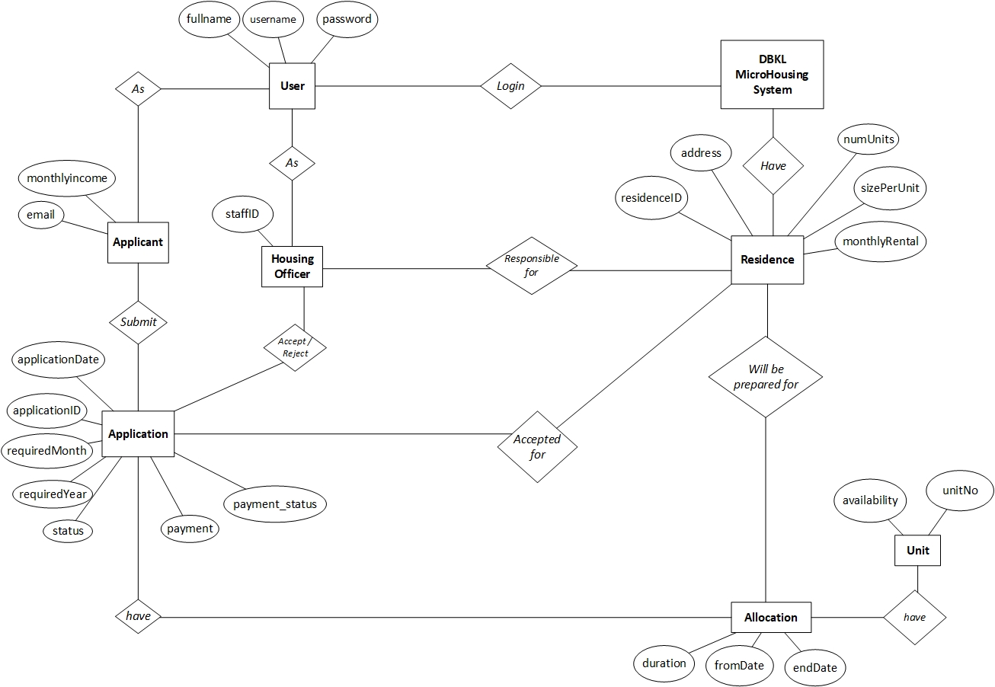

Slide 25
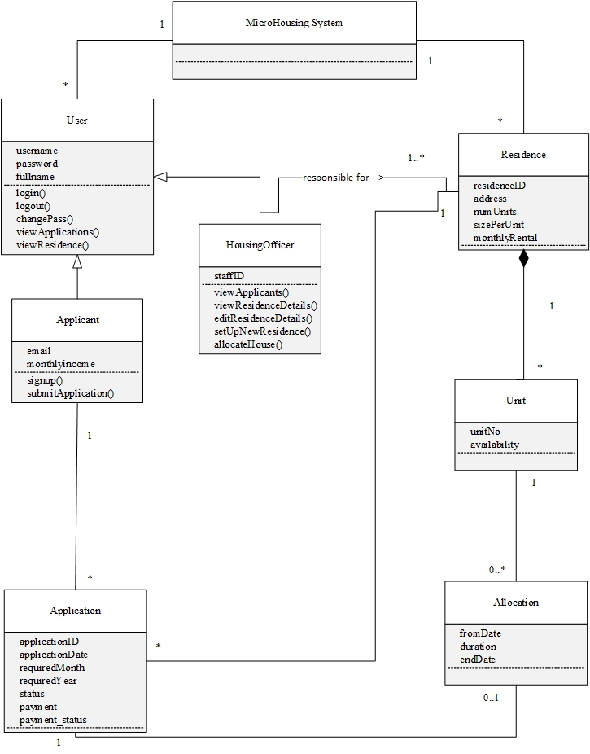

Slide 26
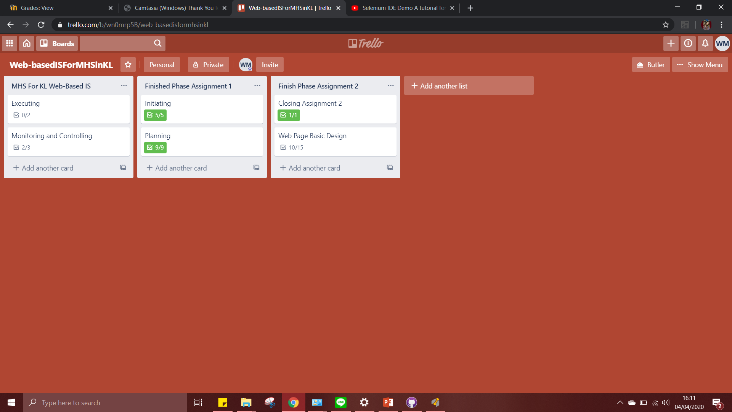

Slide 27
